Slide 1
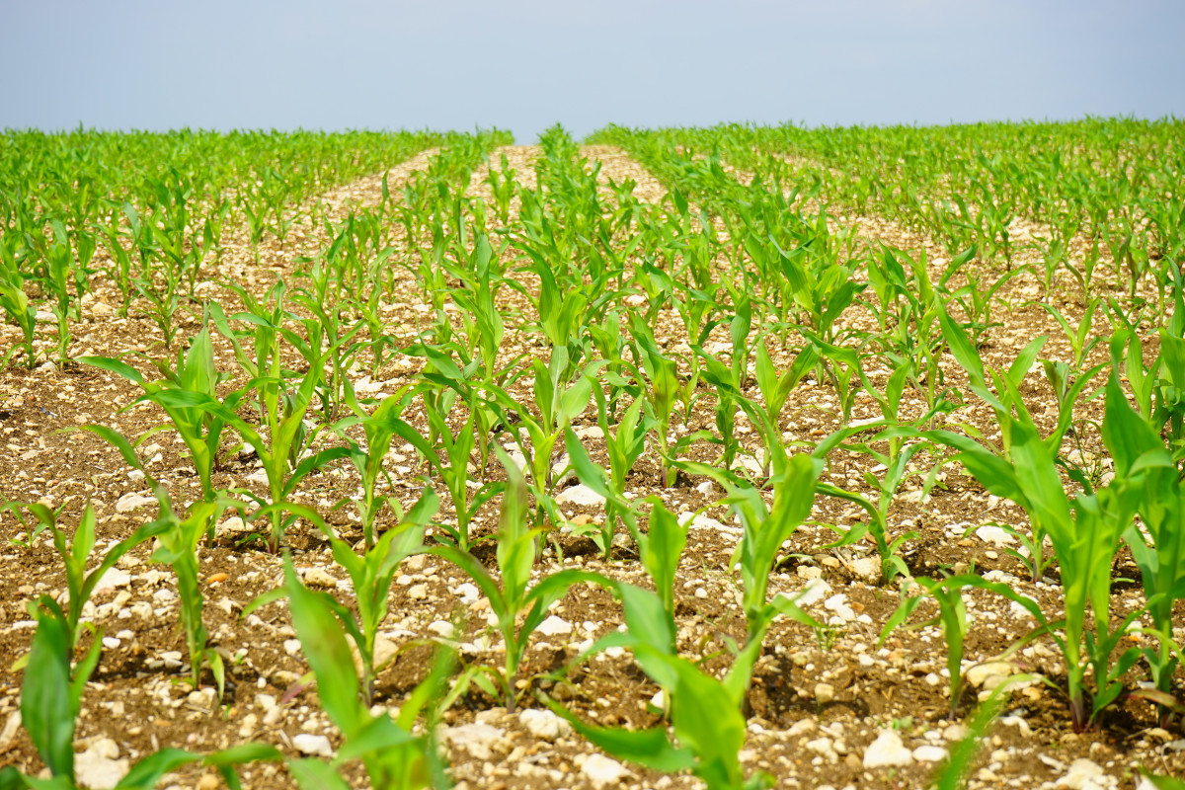
Crop Production Analysis in India

Slide 2
Introduction
Crop production is the practice of growing crops for food and fiber, and is a
branch of agriculture. A characteristic feature of plant growing is
seasonality, depending on weather and natural-climatic conditions
The ultimate goal would be to predict crop production and find important
insights highlighting key indicators and metrics that influence crop
production.

Slide 3
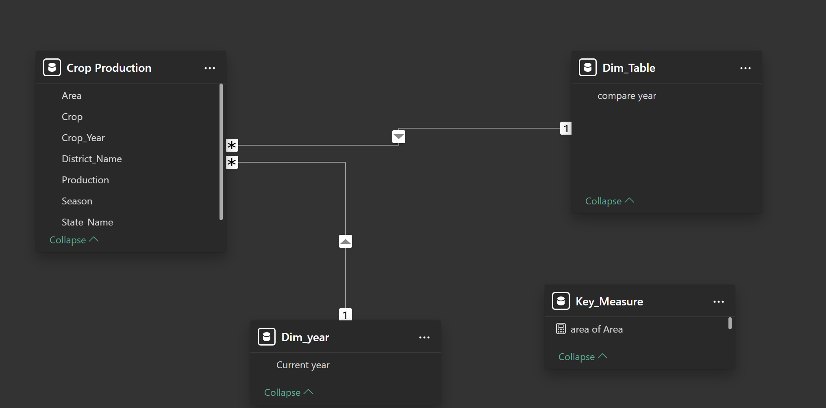
Details of Data

Slide 4
Main KPIs
Find out the states and crop who has the highest production
Calculate the area required per production
Measures the total crop production relative to the area of land used.State wise production and area
Tracks the total cost incurred to produce or deliver a single unit of product/service.
Collect data throughout the crop cycle

Slide 5
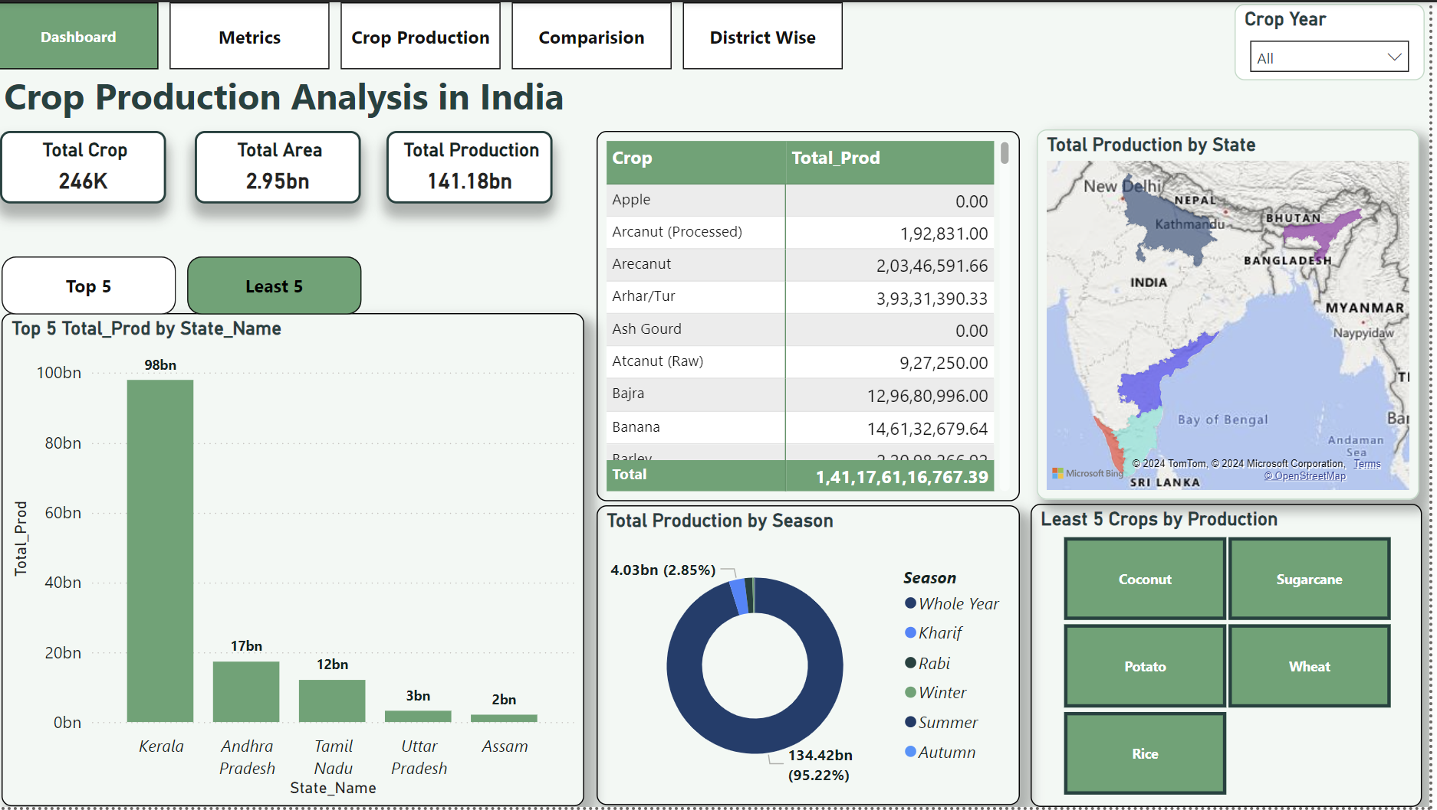
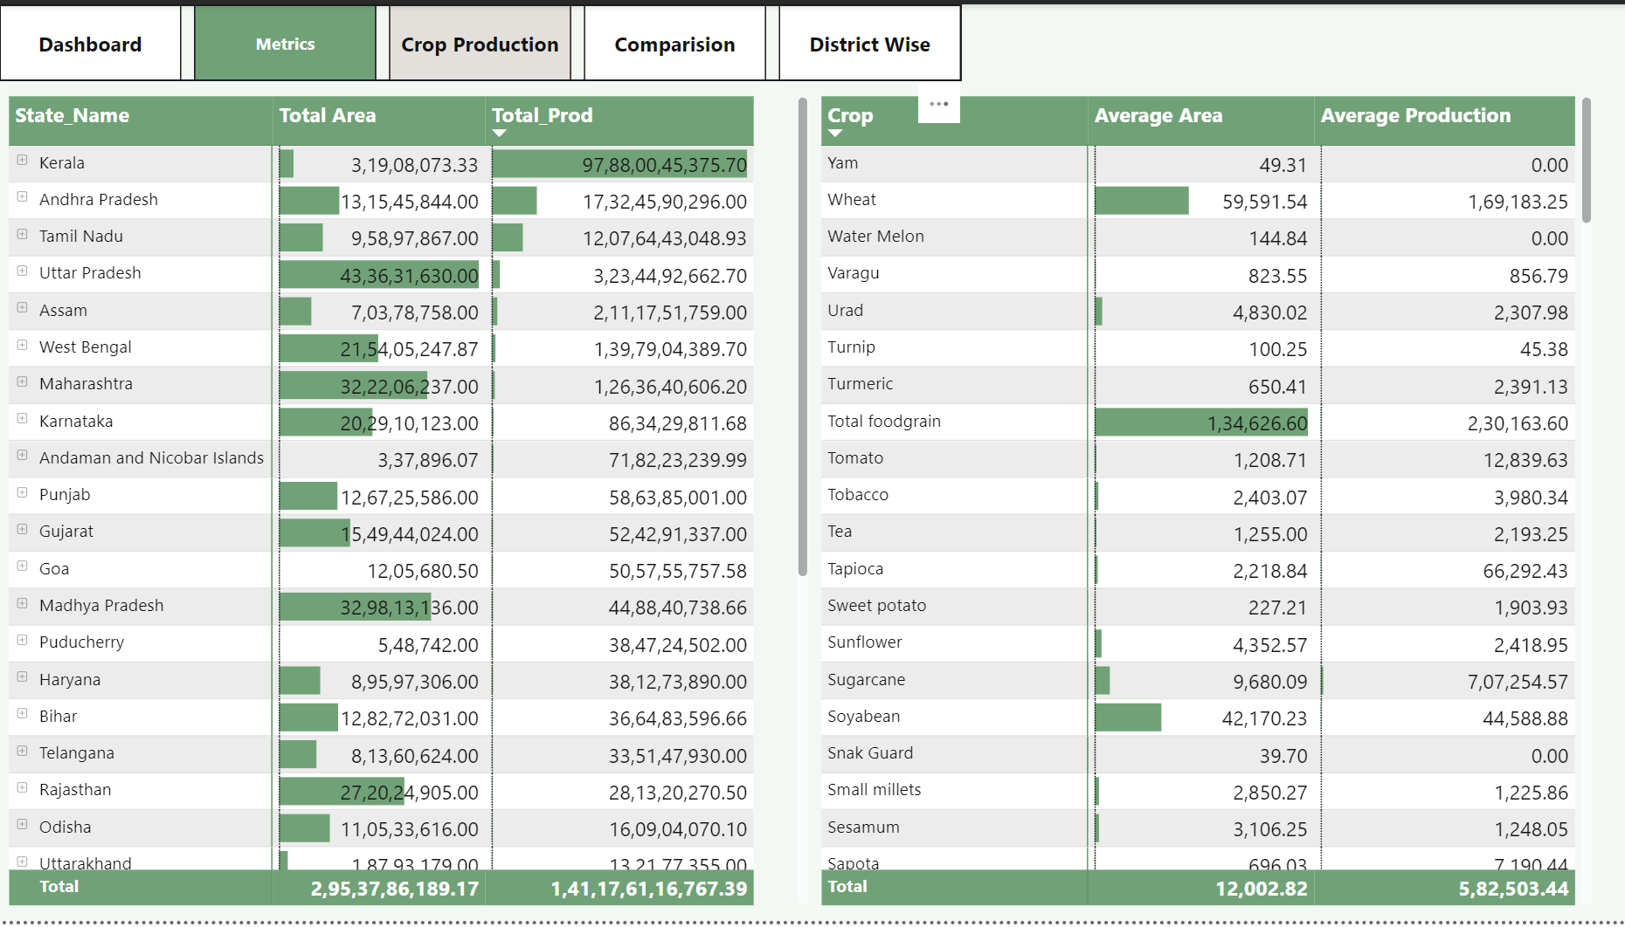
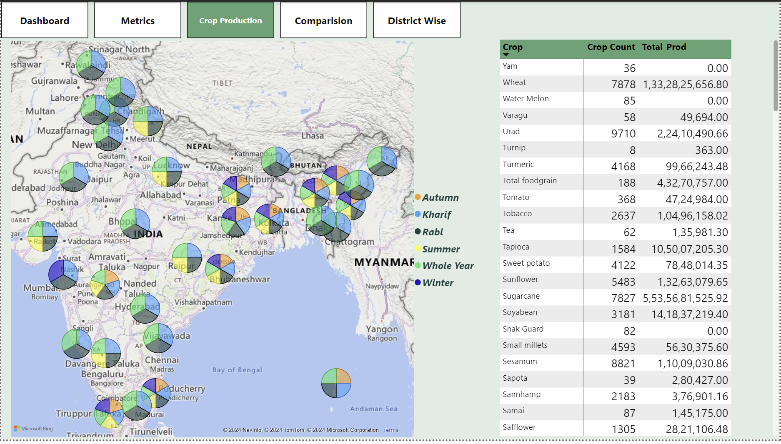
My Design

Slide 6
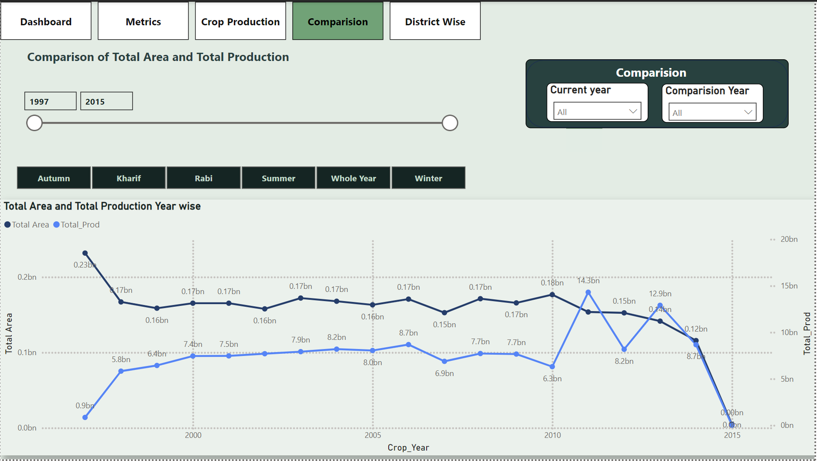
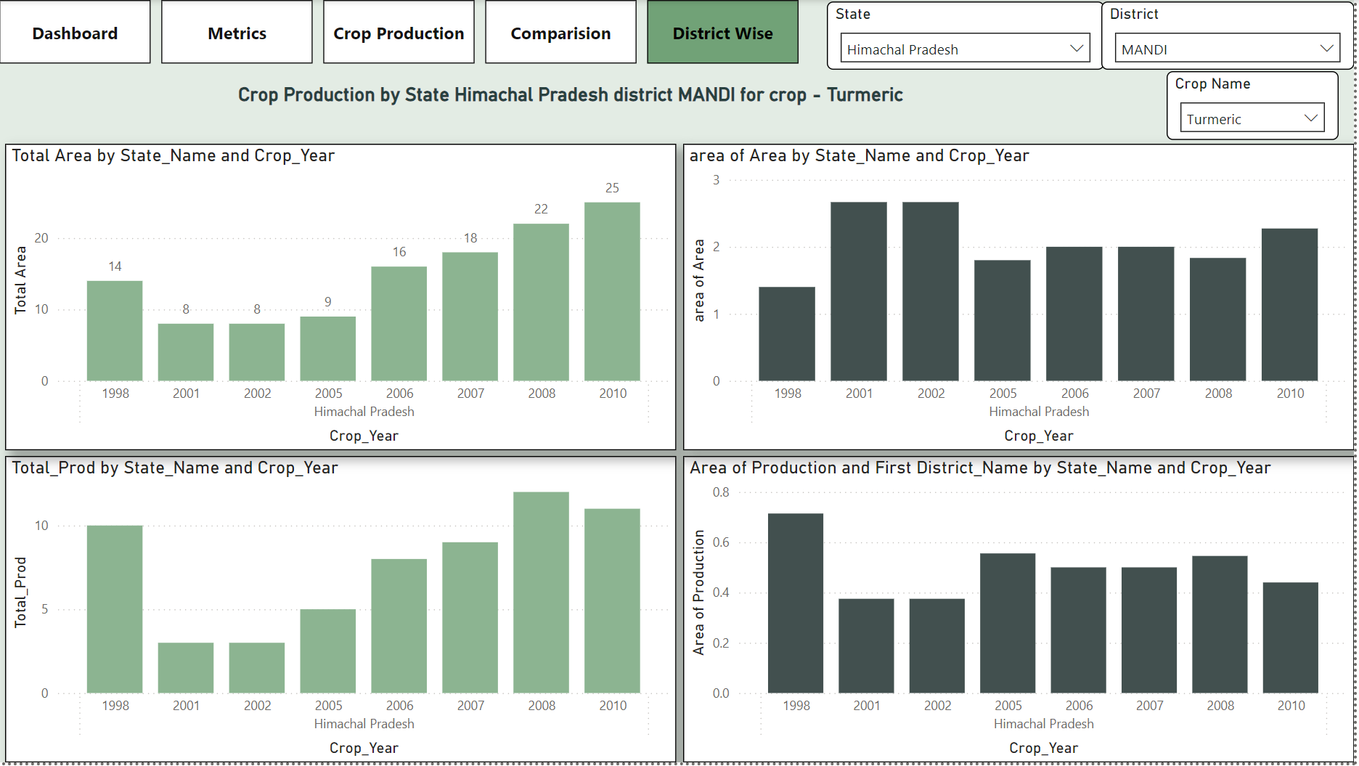
My Design

Slide 7
Thank you

